Slide 1
The Niceifier
By Team Include.JTeam

Slide 2
The Problem
Online Harassment due to:
Lack of conscious (drowsiness)
Grumpiness
Negative Personalities
Intolerance
Pessimism
Terrible People

Slide 3
The Objectives of Niceifier
Make sure no messages of harassment are sent online
Grammatically replace negative keywords with positive ones
Provide a simple and easy to use interface
Make both sides of an online conversation enjoyable
Make all messages “Nice”

Slide 4
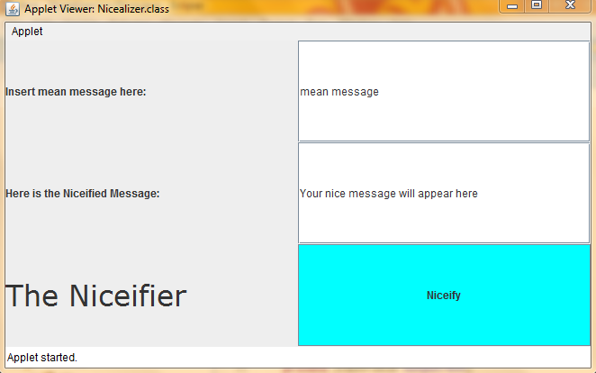
How it Works
Run Applet
Input possible harmful message into text field
It the “Niceify” button
Read / copy the output from the second text field

Slide 5
Applications
Easy copy and paste away for emails and instant messaging
Unnecessary to send message immediately (early review)
Textfield saves original text for possible minor changes
Could be used for Personal, Academic, or Business purposes

